Slide 1
Perceptions of Nuclear Energy among University Students
Andrew Elisalde & Andrew Ramirez
Spring 2016
Advisors:
Dr. Shigeko Sekine
Dr. Yoshiko Saito-Abbott

Slide 2
Outline
Significance of the Study
Research Questions
Literature Review
History of Nuclear Energy
Energy Production and Consumption
Research Method
Conclusion
Bibliography

Slide 3
Significance of the Study
Reducing carbon emissions has become a high priority in today’s society. Nuclear energy is a key component in accomplishing this goal
While studying abroad in Japan, many students seemed to hold a more neutral opinion of nuclear energy, despite the recent disaster in Fukushima
Americans tended to be more negative about nuclear energy, despite not experiencing any nuclear related incidents
This difference was very interesting and inspired us to do research about nuclear energy, how it is perceived in Japan and America, and what students think about using nuclear energy.

Slide 4
Research Questions
How knowledgeable are students on how nuclear energy works?
What are the perceptions of University students about the use of nuclear energy?
What are students’ perceptions of potential future energy sources?

Slide 5
Literature Review
History of Nuclear Energy
Beginnings of Nuclear Energy
American Nuclear Development
Japanese Nuclear Development
List of Major Disasters
Nuclear Energy Production & Consumption
Nuclear Reactors in the World
World Nuclear Energy Production
Nuclear Energy Production: America vs. Japan
Nuclear Energy Consumption: America vs. Japan

Slide 6
Beginnings of Nuclear Energy
1932
James Chadwick discovers the neutron
1938
Nuclear fission is discovered by Otto Hahn and Fritz Strassmann
1942
The Manhattan Project is formed during WWII to develop the atom bomb
1946
High military costs require governments to pursue civilian applications
1954
The first plant to generate electricity on a grid opens in Obninsk, Russia
1956
World’s first commercial nuclear power plant opens in Windscale, England
(International Atomic Energy Agency, 2015)

Slide 7
Development of Nuclear Energy: America
1945
United States drops atomic bomb on Hiroshima and Nagasaki
1946
Atomic Energy Act created to promote civilian nuclear power research
1951
Nuclear fission creates usable electricity by powering 4 lightbulbs
1958
First U.S. commercial nuclear plant opens in Shippingport, Pennsylvania
1960’s
Fierce opposition to nuclear energy begins
1970’s
Nuclear growth becomes stagnant
(International Atomic Energy Agency, 2015)

Slide 8
Development of Nuclear Energy: Japan
1954
Nuclear energy research begins
1966
First nuclear reactor built in Tokai
1995
Cover-ups hurts image of nuclear energy
2002
Japan announces future reliance on nuclear energy
2007
Joint research agreement signed with U.S.
2011
Public support nosedives after Fukushima disaster
(International Atomic Energy Agency, 2015)

Slide 9
Major Disasters
Fukushima nuclear disaster (INES level 7)
2011: A tsunami caused three nuclear meltdowns in Fukushima, Japan.
Chernobyl disaster (INES level 7)
1986: An explosion released radioactive particles, which spread over much of the western USSR and Europe.
Kyshtym nuclear disaster (INES level 6)
1957: Failure to follow proper procedures lead to a powerful explosion in Kyshtym, Russia
Three Mile Island accident (INES level 5)
1979: Nuclear reactor coolant escaped in Dauphin County, Pennsylvania
International Nuclear Event Scale (INES)
(World Nuclear Association, 2015)

Slide 10
Nuclear Reactors in the World
More than 11% if the world’s electricity is from nuclear power
There are over 400 operational commercial nuclear reactors in the world
The Fukushima disaster resulted in many countries shutting down reactors and stopping plans for increased nuclear capacity
Over 140 naval vessels are powered by small nuclear reactors, particularly submarines.
(Luoma-Aho, 2009)
(Duffy, 2013)

Slide 11
Nuclear Generation by Region
Nuclear energy production is a large component of total world energy production
Nuclear energy holds significance particularly in Europe, America, and Asia
Since its introduction, nuclear energy has increased substantially over the years
(Luoma-Aho, 2009)

Slide 12
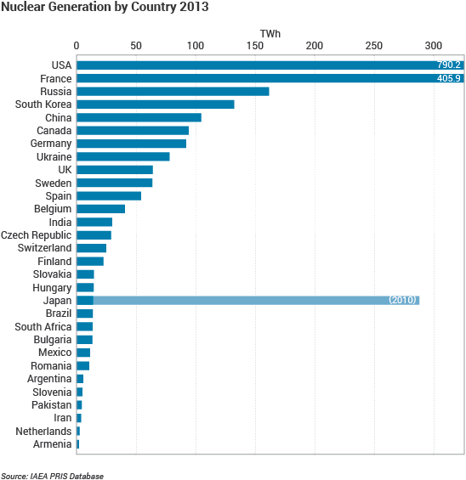
Nuclear Generation by Country
The United States has been, and continues to be, a leader in nuclear energy production
Many countries have significant investment in nuclear energy and choose to use it as a major source
Before the Fukushima disaster, Japan was a top producer of nuclear energy. Since then, Japan has shut down many of its reactors
(Duffy, 2013)

Slide 13
Energy Production
America
Japan
21% of America’s total energy production is nuclear
Nuclear energy is the third most produced energy source
Coal is the most produced source
Renewable sources produce the least amount of energy
Before Fukushima, nuclear energy was the second highest energy producer. Now produces less than 5%
Coal produced 28%, the most in the Japan
10% comes from renewable sources
(World Nuclear Association, 2015)

Slide 14
Energy Consumption
America
Japan
Petroleum is the leading source of consumed energy at 45%
13% of consumed energy comes from nuclear energy
6% of consumed energy comes from hydro
45% of consumed energy comes from petroleum
Before Fukushima, 13% of consumed energy was nuclear energy, now only 1%
Only 1% of consumed energy comes from renewable sources
(World Nuclear Association, 2015)

Slide 15
Research Method
Study Participants: 68 Participants total
34 American, 34 Japanese students
Demographics:
American university students: 14 male, 19 female, 1 other
Japanese university students: 7 male, 27 female
Research Instrument: Japanese/English online survey (Google Docs)

Slide 16
Research Question 1
How knowledgeable are students on how nuclear energy works?

Slide 17
Nuclear Energy Knowledge
Which raw material is used to generate energy at nuclear power stations?
Nuclear power plants are often associated with giant cooling towers. What do these towers emit?
Both American and Japanese students were often able to get basic nuclear energy questions correct.

Slide 18
Advanced Knowledge
A nuclear reactor can explode like a nuclear weapon if...
Japanese students were less knowledgeable about questions that required in-depth knowledge about nuclear fission.
65% of Japanese students thought nuclear reactors can explode like nuclear weapons

Slide 19
Regional Knowledge
How many commercial nuclear power stations are currently operating in your country?
59% of Japanese students know the amount of nuclear reactors in Japan. 89% of Americans did not know the amount of nuclear reactors in the United States

Slide 20
Nuclear Waste
I think that stored nuclear waste is at high risk of leaking into the environment
What is the composition of most high-level nuclear waste?
Both American and Japanese students agreed that nuclear waste is likely to leak into the environment. However, neither group knew what most nuclear waste actually was made of.

Slide 21
RESEARCH QUESTION 1 FINDINGS SUMMARY
American and Japanese students have a low understanding of how nuclear energy works
The Fukushima Daiichi disaster is the 2nd worst nuclear disaster in history, but has had little effect on public education of nuclear energy
Students’ knowledge of nuclear energy comes from perceived stereotypes
50% of all students thought nuclear waste was liquid or plasma
53% of all students thought a reactor can explode like a nuclear weapon

Slide 22
Research Question 2
What are the perceptions of university students about
the use of nuclear energy?

Slide 23
Thoughts on Nuclear Energy
How do you feel about the current use of nuclear energy in your country?
Japanese students were much more likely to “choose” a side. Only 12% were unsure
41% of Japanese felt positive, while 47% felt negative
38% of Americans felt positive, while 26% felt negative

Slide 24
Thoughts on Current Projections
In the next decade, I think my country's nuclear energy demand will...
70% of American students predicted an increase, 17% predicted a decrease
50% of Japanese students predicted a decrease, 29% predicted an increase

Slide 25
Thoughts on Nuclear Accidents
Nuclear power accidents are common occurrences
Both American and Japanese students disagree that nuclear power accidents occur often
Only 19% of all students thought nuclear accidents happen often

Slide 26
Government Policies
I feel that government policies on nuclear energy keep me safe
47% of American students were unsure about government policies
76% of Japanese students felt unsafe with their government’s policies

Slide 27
RESEARCH QUESTION 2 FINDINGS SUMMARY
Student opinion about nuclear energy was mixed
Japanese students tended to be more negative
Knowledge and opinion of nuclear energy are directly related:
The more questions a student answered correctly during the quiz portion, the more favorable their opinion was of nuclear energy
Opinions vary greatly depending on country
Japanese students were more negative, influenced by the 2011 Fukushima Daiichi disaster
Americans were more neutral; there have been no major nuclear incidents in the U.S. since 1979

Slide 28
Research Question 3
What are students’ perceptions of potential future energy sources?

Slide 29
Effect on Environment
I Believe Nuclear Energy Can Help Reduce Carbon Emissions
50% of Japanese students agreed that nuclear energy can help reduce CO2 emissions
44% of Americans agreed
21% of Japanese and 35% of Americans remained unsure

Slide 30
Nuclear Infrastructure
We should build more nuclear power plants in the future
We should restart nuclear reactors that have been deactivated
Despite the sentiment that nuclear energy can help the environment, 41% of all students did not want to build new reactors. 60% of all students did not want to restart existing reactors

Slide 31
Priority
Renewable sources should take priority over nuclear energy
Other renewable sources have more potential than nuclear energy
Japanese and American students believe that renewable options have more potential and should take higher priority over nuclear energy

Slide 32
Outlook
Which will be your country's main source for electricity 10 years from now?
58% of all polled students believe a renewable energy source will be their country's main source of energy in just 10 years
Solar power is overwhelmingly the most popular prediction as the main power source in a decade

Slide 33
RESEARCH QUESTION 3 FINDINGS SUMMARY
Despite knowing nuclear energy can reduce CO2 emissions, students do not want new reactors built or restart existing reactors
Nuclear energy is avoided because there is a higher perceived risk
Students put a high priority on environmental impact
Students overvalue what renewable sources are capable of
Expectations of energy sources are unrealistic
58% of all students thought renewable energy would be the most used energy source in just 10 years

Slide 34
Conclusion
Many factors influence the perception of nuclear energy
Factors such as country, recent disasters, and popular opinion
Stereotypes play a significant role when considering nuclear energy
Recurring themes of leaking radiation, liquid waste, and other harmful effects
Japanese students were more negative about nuclear energy
Possible influence from the 2011 Fukushima Daiichi disaster
Americans were less concerned and opinions varied
American students have not experienced a nuclear disaster

Slide 35
Conclusion & Discussion
Awareness about nuclear energy can directly effect perceptions
Students that did well on the quiz tended to be positive about nuclear energy
Nuclear energy is seen as an effective way to lower CO2 emissions
Few would prefer this over renewable sources, given the choice
This project has made us realize the importance of raising awareness about nuclear energy on campus
It is important to be proactive learning about nuclear energy and not wait for an accident
We also learned the importance of using all energy sources
Students should understand that no single energy source is the answer

Slide 36
Limitations of the Study
Majority of respondents came from 2 schools (CSUMB & University of Shiga Prefecture)
Demographics (21 men were surveyed compared to 46 women)
Future Study
Explore the impact of media on students’ opinions
Survey college instructors’ knowledge/opinion of nuclear energy

Slide 37
Bibliography
Bazile, F. (2012). Social impacts and public perception of nuclear power. Infrastructure and Methodologies for the Justification of Nuclear Power Programmes, 549-566. doi:10.1533/9780857093776.2.549
Duffy, D. (2013). Energy Generation: Nuclear Energy. Walsh/Computational Computational Approaches to Energy Materials, 71-107. doi:10.1002/9781118551462.ch3
Friedman, R. S. (1991). American Nuclear Energy Policy, 1945–1990: A Review Essay. J. Policy Hist. Journal of Policy History, 3(03), 331-348. doi:10.1017/s0898030600006321
Gamson, W. A., & Modigliani, A. (1989). Media Discourse and Public Opinion on Nuclear Power: A Constructionist Approach. American Journal of Sociology, 95(1), 1-37. doi:10.1086/229213
Lowe, I. (n.d.). Renewable Energy Technologies: Key to Sustainable Futures. The International Handbook on Environmental Technology Management. doi:10.4337/9781847203052.00038
Luoma-Aho, V., & Vos, M. (2009). Monitoring the complexities: Nuclear power and public opinion. Public Relations Review, 35(2), 120-122. doi:10.1016/j.pubrev.2009.01.013
Murata, H. (1984). Nuclear power development in Japan. Energy, 9(9-10), 751-759. doi:10.1016/0360-5442(84)90006-9
Nuclear Safety and Regulation. (2008). Nuclear Energy Outlook 2008, 212-237. doi:10.1787/9789264054110-9-en
Peelle, E. (1976). Social Impacts Of Nuclear Power Plants. Environmental Impact of Nuclear Power Plants, 336-348. doi:10.1016/b978-0-08-019956-6.50020-9
Taniguchi, T., Ishida, S., & Minami, Y. (2013). A Feasibility Study on Hybrid Use of Ocean Renewable Energy Resources Around Japan. Volume 8: Ocean Renewable Energy. doi:10.1115/omae2013-11040

Slide 38
Media Sources
Historical Timeline - Alternative Energy - ProCon.org. (n.d.). Retrieved January/February, 2016, from http://alternativeenergy.procon.org/view.timeline.php?timelineID=000015
Historical Timeline - Alternative Energy - ProCon.org. (n.d.). Retrieved January/February, 2016, from http://alternativeenergy.procon.org/view.timeline.php?timelineID=000015
How Nuclear Power Works. (n.d.). Retrieved January/February, 2016, from http://www.ucsusa.org/nuclear- power/nuclear-power-technology/how-nuclear-power-works#.VjpYcfnF_uQ
International Atomic Energy Agency (IAEA). (n.d.). Retrieved January/February, 2016, from http://www- pub.iaea.org/books/IAEABooks/10881/Advances-in-Nuclear-Forensics-Countering-the-Evolving-Threat-of- Nuclear-and-Other-Radioactive-Material-out-of-Regulatory-Control
World Nuclear Association. (n.d.). Retrieved January/February, 2016, from http://www.world-nuclear.org/

Slide 39
Acknowledgments
Dr. Shigeko Sekine
Dr. Yoshiko Saito-Abbott
Dr. Chikaomi Takahashi
Anri Okoshi
Our Capstone Peers

Slide 40
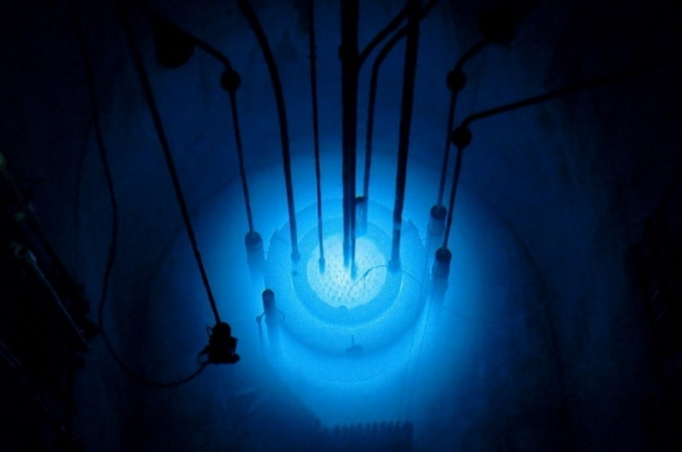
Thank You For Listening!

